Slide 1
SECURE DATA HIDING IN IMAGE USING STEGANOGRAPHY
CAPSTONE PROJECT
Presented By: ARYAN RAJESH PANDE
Student Name : ARYAN RAJESH PANDE
College Name & Department : PRMIT,R&CSE

Slide 2
OUTLINE
Problem Statement
Technology used
Wow factor
End users
Result
Conclusion
Git-hub Link
Future scope

Slide 3
Problem Statement
Steganography is a technique used to hide secret information within a medium, such as an image, making it undetectable to unauthorized users.
With increasing concerns over data privacy, there is a need for secure methods of communication.
This project aims to create a system that hides a secret message within an image using passcode-based encryption, ensuring that only authorized users can access the hidden data.
The message is embedded by altering the least significant bits of the image pixels, providing a secure and efficient way to protect sensitive information.

Slide 4
Technology used
Python: The programming language chosen for developing the steganography system, facilitating image manipulation and data processing.
OpenCV (cv2): A popular library in Python that enables the reading, editing, and saving of image files, which is essential for embedding and extracting hidden data within images
Passcode-Based Encryption: A simple encryption method that uses a passcode to ensure that only authorized users can access the hidden message.
Image Processing Techniques: Methods like Least Significant Bit (LSB) manipulation are employed to securely embed the secret message within an image, making it imperceptible to the naked eye.

Slide 5
Wow factors
Efficient Pixel Manipulation
Passcode-Based Security
Minimal Code Complexity
Real-Time Image Viewing
Dynamic Message Embedding
Cross-Platform Compatibility

Slide 6
End users
Individuals
People who need to securely share personal or confidential information without revealing the presence of the message, such as private communications between friends or family.
Cybersecurity Professionals
Experts who analyze digital forensics and secure communication channels, and who might use steganography for detecting hidden data or securing sensitive information.
Researchers and Academics
Students or researchers in fields like cryptography, image processing, and data security who want to study or experiment with steganography and encryption techniques.
Software Developers
Developers building secure communication applications or tools that require the integration of hidden messaging systems for privacy or protection of intellectual property.
Businesses and Organizations
Companies looking for non-obtrusive ways to protect sensitive information, such as transferring secure documents or intellectual property via image-based channels.
Government Agencies
Security and intelligence agencies that require discreet communication channels to exchange classified or sensitive data.
Digital Artists and Content Creators
Professionals in creative industries who may use the technique for watermarking or embedding hidden messages within digital content to protect copyrights or convey hidden information.

Slide 7
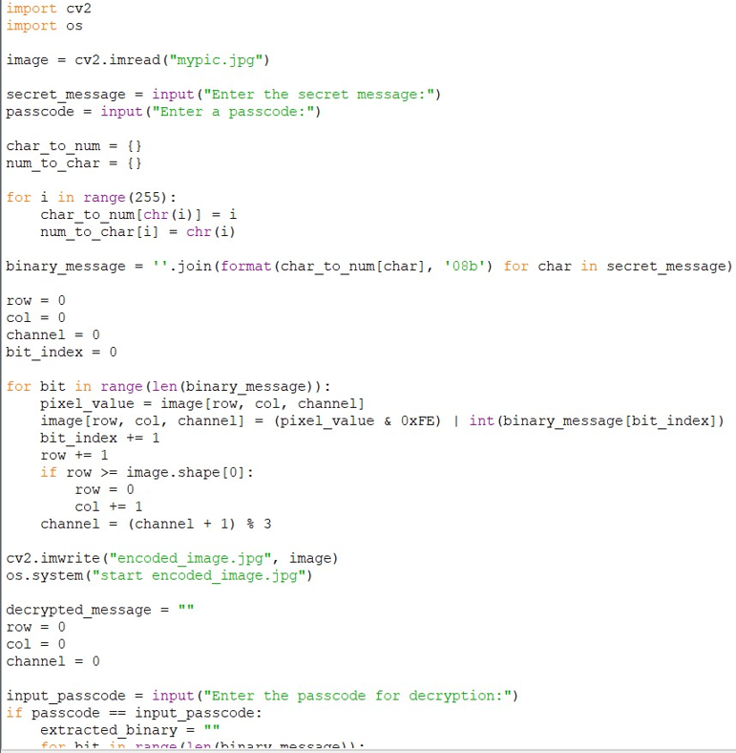
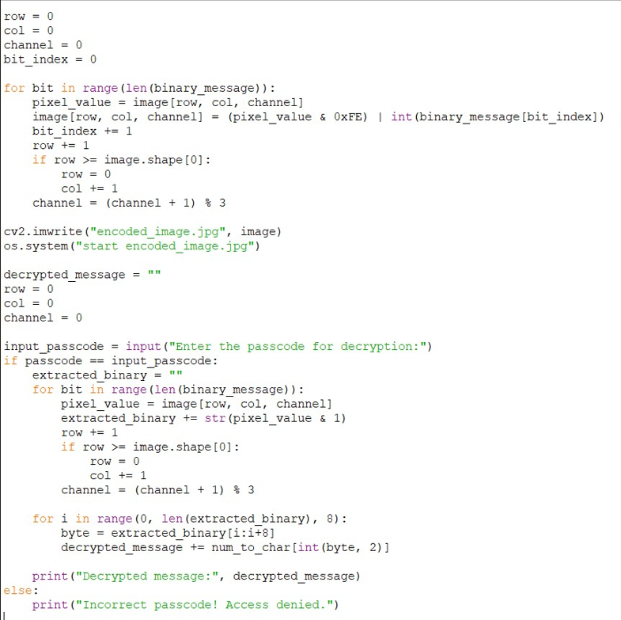

Results

Slide 8
Conclusion
The Secure Data Hiding in Image Using Steganography project provides an effective solution for securely embedding messages within images.
By using the Least Significant Bit (LSB) technique along with passcode-based encryption, the system ensures that only authorized users can retrieve the hidden information.
This project offers a simple yet powerful approach to protecting sensitive data, making it ideal for individuals, organizations, and professionals who need secure communication channels.
It combines the power of image processing, encryption, and steganography, providing a practical tool for digital privacy.

Slide 9
GitHub Link
https://github.com/aryan30010/ar/blob/main/Steganography.py

Slide 10
Future scope(optional)
The Secure Data Hiding in Image Using Steganography project has several potential directions for further development.
One area for improvement is the integration of more advanced encryption techniques, such as AES (Advanced Encryption Standard), to enhance the security of hidden data.
Additionally, supporting other media formats, such as audio and video, for data hiding could expand the versatility of the system.
The project could also explore the use of machine learning algorithms to detect and protect against attacks or attempts to alter hidden messages.
Furthermore, improving the user interface to make the system more intuitive would enhance its accessibility for a broader range of users.
As data privacy concerns continue to grow, this project has significant potential for further innovation in secure communication and information protection.

Slide 11
THANK YOU

